Slide 1




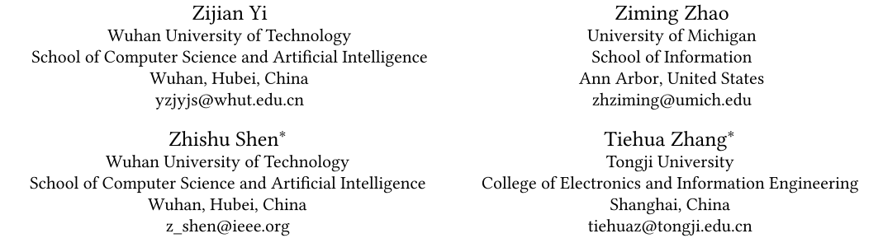





ATAI
Advanced Techniqueof Artificial Intelligence
ATAI
ChongqingUniversity _{AdvancedTechniqueof}
of Technology Artificial Intelligence
Chongqing University of
Technology
Chongqing University ^{ATAI}
_{of Technology} Advanced Techniqueof
Artificial Intelligence
Chongqing University of Technology
Chongqing University of Technology
Dynamic Diffusion Transformer
—— ICLR 2025
Code:https://github.com/NUS-HPC-AI-Lab/ Dynamic-Diffusion-Transformer.
Reported by Tingting Zhang
1

Slide 2

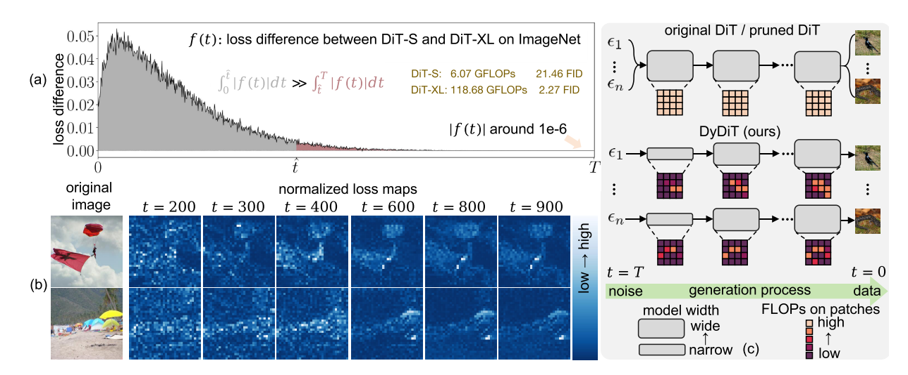
ATAI
AdvancedTechniqueof
Artificial Intelligence
ATAI
ChongqingUniversity _{AdvancedTechniqueof}
of Technology Artificial Intelligence
ChongqingUniversity of Technology
Motivation
a) Timestep perspective: excessive computational costs at timesteps where the task complexity is low.
b) Spatial perspective: uniform computational treatment of all patches introduces redundancy and is likely suboptimal.
Notes:
1. 不同扩散时间步（timestep）的噪声预测任务难度不同。当时间步较大, 任务难度显著降低，此时即使小模型也能胜任。传统DiT在所有时间步采用相同计算量，导致高难度时间步资源不足，而低难度时间步存在冗余计算。
2. 图像不同区域的噪声预测难度存在显著差异.主体区域（如动物、物体）的预测损失较高，背景区域（如天空、纯色区域）损失较低。
统一计算所有图像块（patch）导致对简单区域的过度计算。

Slide 3

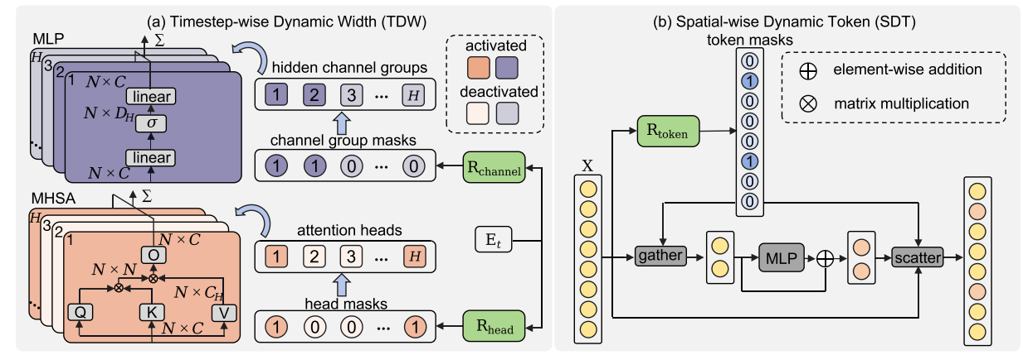
ChongqingUniversity of Technology
ATAI
AdvancedTechniqueof
Artificial Intelligence
ATAI
ChongqingUniversity _{AdvancedTechniqueof}
of Technology Artificial Intelligence
Overview

Slide 4

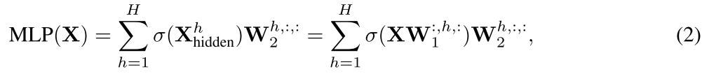
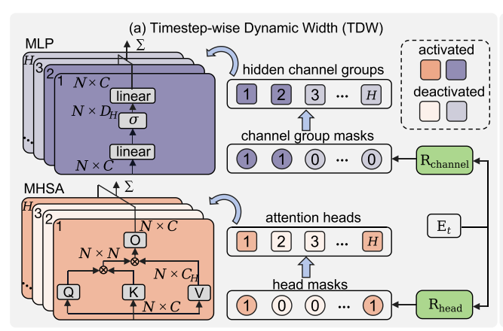
ChongqingUniversity of Technology
ATAI
AdvancedTechniqueof
Artificial Intelligence
ATAI
ChongqingUniversity _{AdvancedTechniqueof}
of Technology Artificial Intelligence
Method

Slide 5
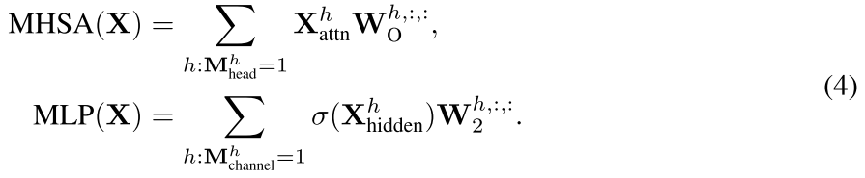
ChongqingUniversity of Technology
ATAI
AdvancedTechniqueof
Artificial Intelligence
ATAI
ChongqingUniversity _{AdvancedTechniqueof}
of Technology Artificial Intelligence
Method

Slide 6
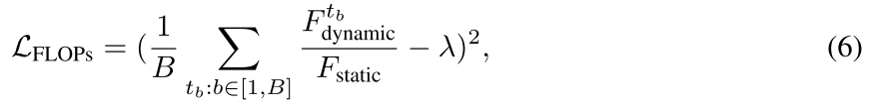
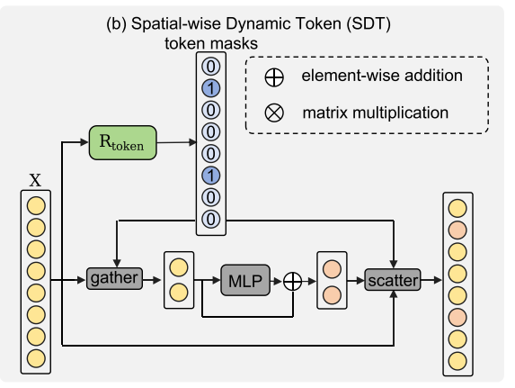
ChongqingUniversity of Technology
ATAI
AdvancedTechniqueof
Artificial Intelligence
ATAI
ChongqingUniversity _{AdvancedTechniqueof}
of Technology Artificial Intelligence
Method
Notes:
MHSA需要所有Token之间的全局交互。
每个Token的注意力权重取决于所有其他Token的键（Key）和查询（Query）。如果动态跳过某些Token，会导致注意力矩阵不完整，破坏全局依赖关系。
MLP对每个Token独立进行逐通道变换。

Slide 7

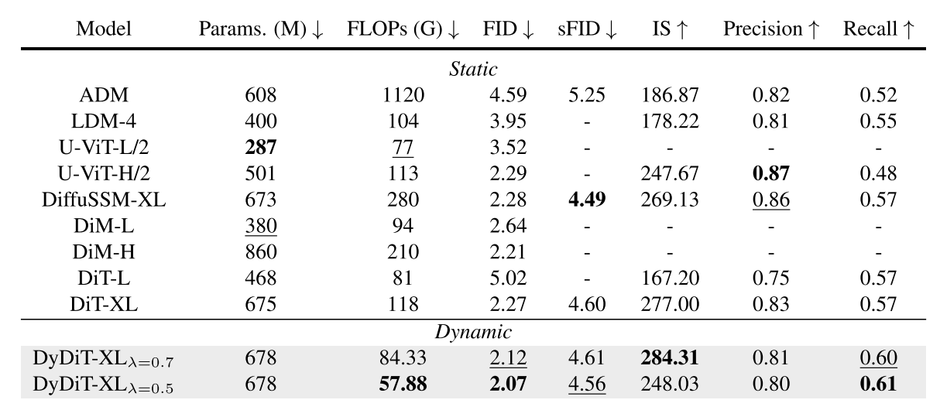
ATAI
AdvancedTechniqueof
Artificial Intelligence
ATAI
ChongqingUniversity _{AdvancedTechniqueof}
of Technology Artificial Intelligence
ChongqingUniversity of Technology
Experiments

Slide 8
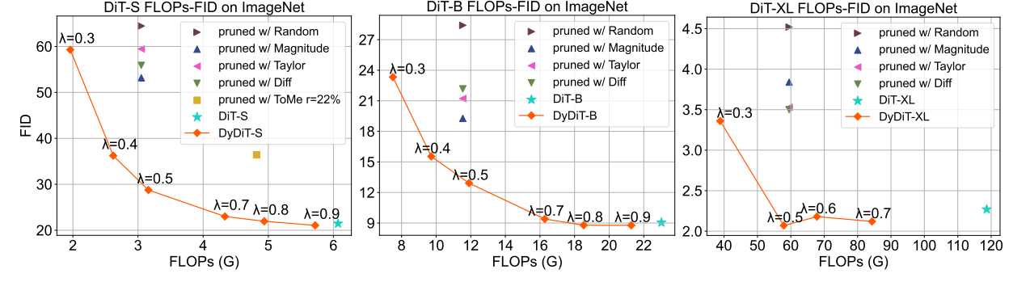
ATAI
AdvancedTechniqueof
Artificial Intelligence
ATAI
ChongqingUniversity _{AdvancedTechniqueof}
of Technology Artificial Intelligence
ChongqingUniversity of Technology
Experiments

Slide 9
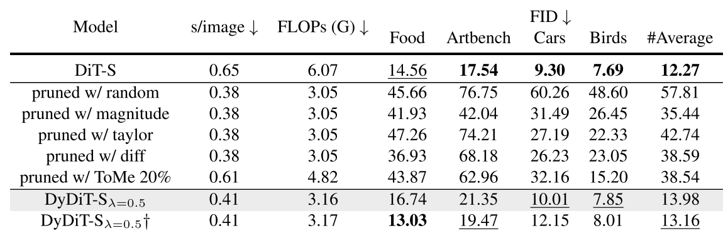
ATAI
AdvancedTechniqueof
Artificial Intelligence
ATAI
ChongqingUniversity _{AdvancedTechniqueof}
of Technology Artificial Intelligence
ChongqingUniversity of Technology
Experiments

Slide 10
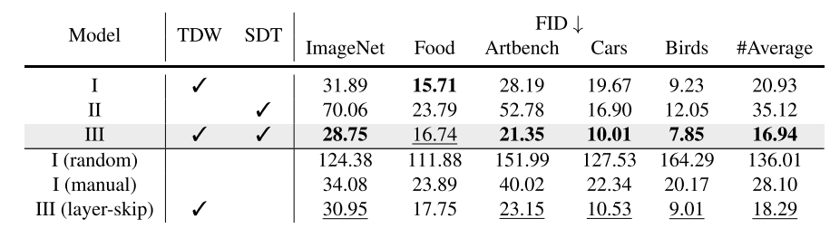
ATAI
AdvancedTechniqueof
Artificial Intelligence
ATAI
ChongqingUniversity _{AdvancedTechniqueof}
of Technology Artificial Intelligence
ChongqingUniversity of Technology
Experiments

Slide 11
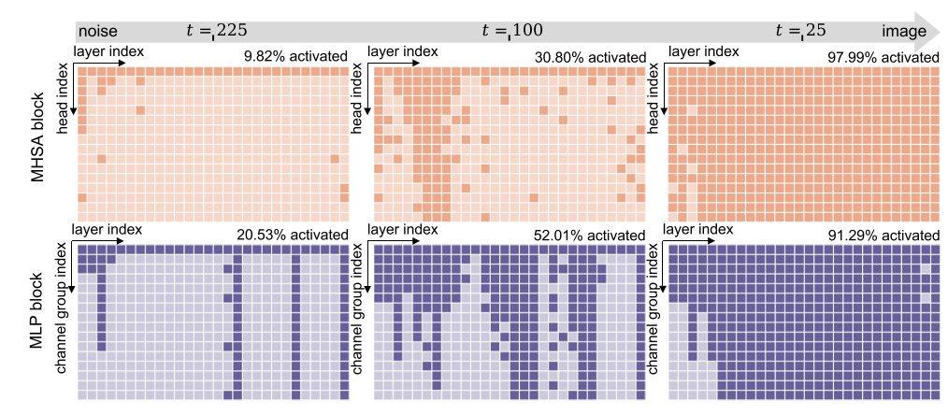
ATAI
AdvancedTechniqueof
Artificial Intelligence
ATAI
ChongqingUniversity _{AdvancedTechniqueof}
of Technology Artificial Intelligence
ChongqingUniversity of Technology
Experiments

Slide 12
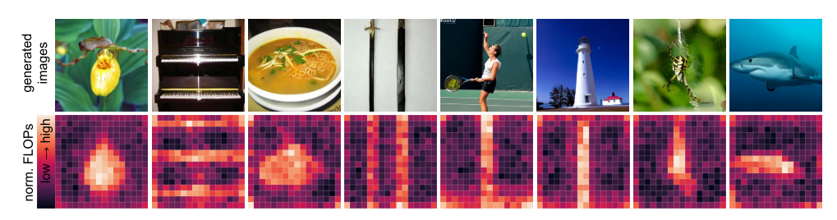
ATAI
AdvancedTechniqueof
Artificial Intelligence
ATAI
ChongqingUniversity _{AdvancedTechniqueof}
of Technology Artificial Intelligence
ChongqingUniversity of Technology
Experiments

Slide 13
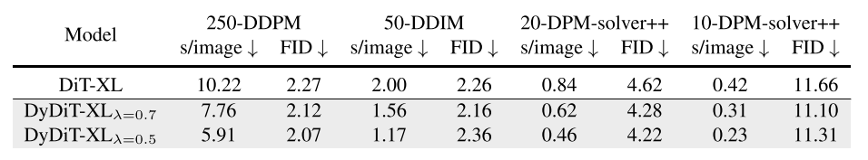
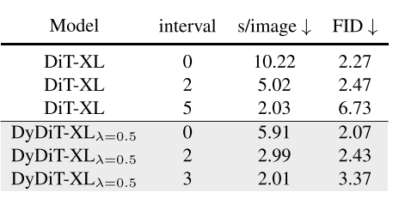
ATAI
AdvancedTechniqueof
Artificial Intelligence
ATAI
ChongqingUniversity _{AdvancedTechniqueof}
of Technology Artificial Intelligence
ChongqingUniversity of Technology
Experiments

Slide 14
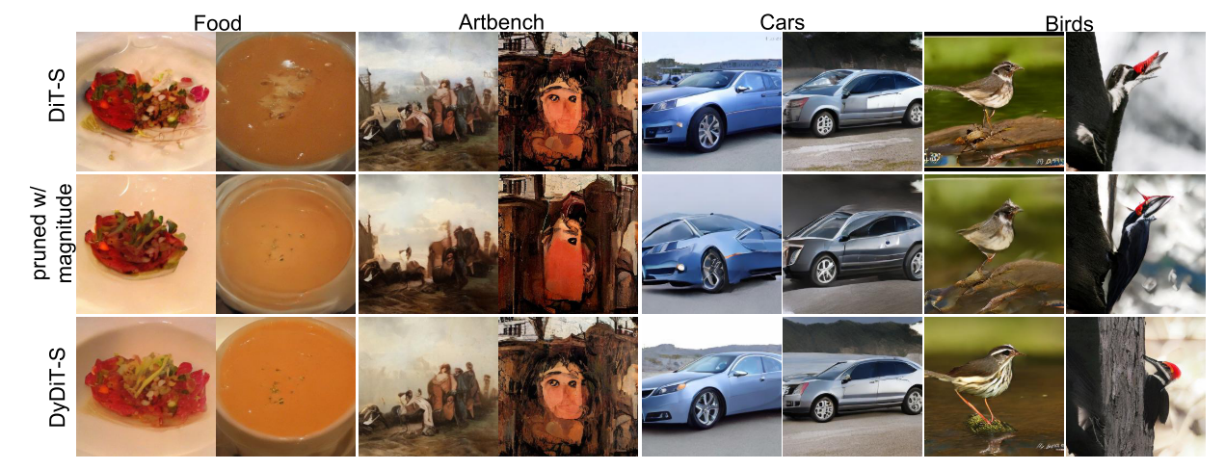
ATAI
AdvancedTechniqueof
Artificial Intelligence
ATAI
ChongqingUniversity _{AdvancedTechniqueof}
of Technology Artificial Intelligence
ChongqingUniversity of Technology
Experiments

Slide 15


ChongqingUniversity of Technology
ATAI
AdvancedTechniqueof
Artificial Intelligence
ATAI
ChongqingUniversity _{AdvancedTechniqueof}
of Technology Artificial Intelligence
Thanks!

